Slide 1
Local
Users and Groups
Windows Advanced Lesson 9.7

Slide 2
TABLE OF CONTENTS
01
02
USERS
USER SETTINGS
03
04
GROUPS
USERS & GROUPS
Listing, Adding, Removing Local Users
Changing Passwords and Policies of Users
Listing, Adding, Removing Local Groups
Adding and Removing Users from Groups

Slide 3
Users
01
Listing, Adding, and Removing Users

Slide 4
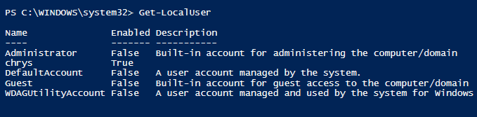
Listing Users: Get-LocalUser
Lists all the local users on the system

Slide 5
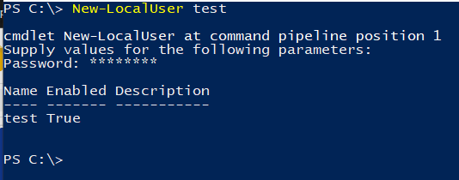

Adding and Removing Users
Use New-LocalUser to add a new Local User
Must specify a Password
Use Remove-LocalUser to remove a Local User

Slide 6
Users Settings
02
Changing Passwords and Policies of Users

Slide 7
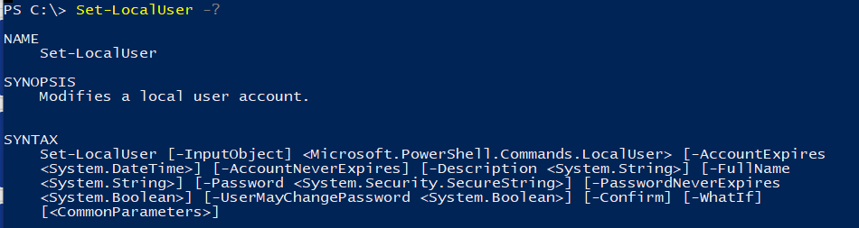
Changing User Settings: Set-LocalUser

Slide 8
Setting User Settings
Most Settings can be set explicitly with True/False
Others like -FullName require strings
Remember that to assign boolean variables, use $True and $False
-AccountExpires and -AccountNeverExpires are toggles, use only one

Slide 9

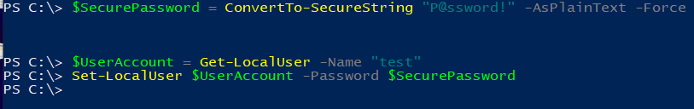
ConvertTo-SecureString
Takes in a regular String input and encrypts it so that it can be used as a password.
NOTE:
Since Passwords are secure, we need to make set them as Secure Strings.

Slide 10
Groups
03
Listing, Adding, Removing Local Groups

Slide 11
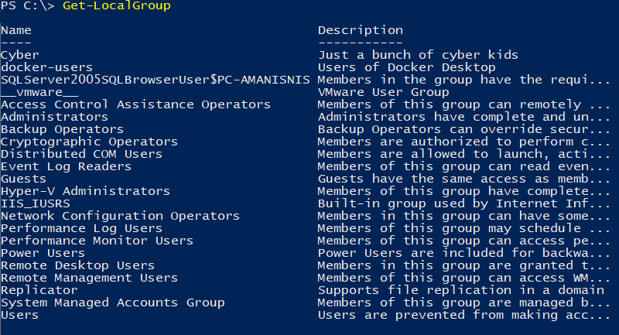
Listing Local Groups:
Get-LocalGroup
Most Settings can be set explicitly with True/False
Others like -FullName require strings
Remember that to assign boolean variables, use $True and $False

Slide 12
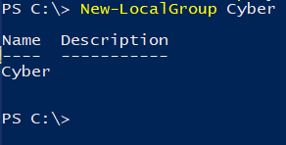

Adding and Removing Groups
Use New-LocalGroup to add a new Local Group
Use Remove-LocalGroup to remove a Local Group

Slide 13
USERS & GROUPS
04
Adding and Removing Users from Groups

Slide 14
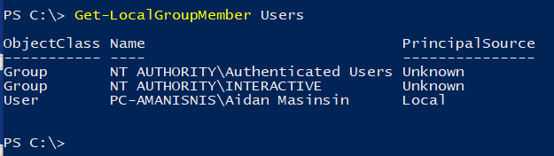
Local Group Members: Get-LocalGroupMember
Lists all the local users in a Group

Slide 15
Adding and Removing Users from Groups
Use Add-LocalGroupMember to add a user to a group
Can be set implictly and explictly
Use Remove-LocalGroup to remove a Local Group
Can be set implictly and explictly

Slide 16
THANKS
Slides made by Aidan Masinsin and Zachary Dang
Please keep this slide for attribution

Slide 17


